Slide 1


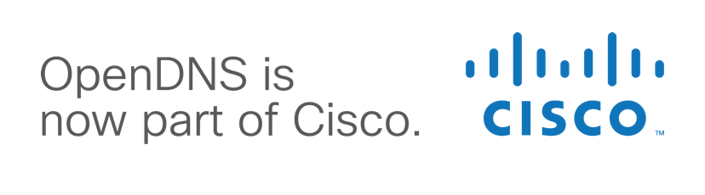
Don’t Fix It, Throw it Away!
PLEASE GO TO THE FOLLOWING URL AND SETUP THE
PRE-REQS + SECTION 0 IF YOU HAVEN’T ALREADY!!
https://www.chrisdorros.com/2016/oscon
Introduction to Disposable Infrastructure
2016-05-17, OSCON 2016
Chris Dorros

Slide 2
Tentative Schedule
1:30 was a few minutes ago
2:00ish Section 1
2:30ish Section 2
3:00-3:30 break
3:30 Section 3
4:00ish Section 4
5:00 end time, stick around for questions/help

Slide 3
Infrastructure as Code
Defining infrastructure (servers, networking, operating systems, processes) as code, and provisioning those components automatically from the code
Declarative language (in general)

Slide 4

Disposable? Immutable?
Disposable - throw your server away, make a new one
  (recycle/compost if you’re in SFO)
Immutable - no changing the server after it’s already deployed.

Slide 5
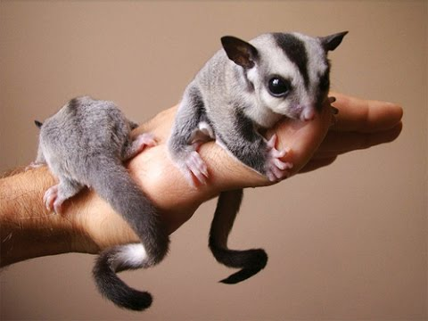
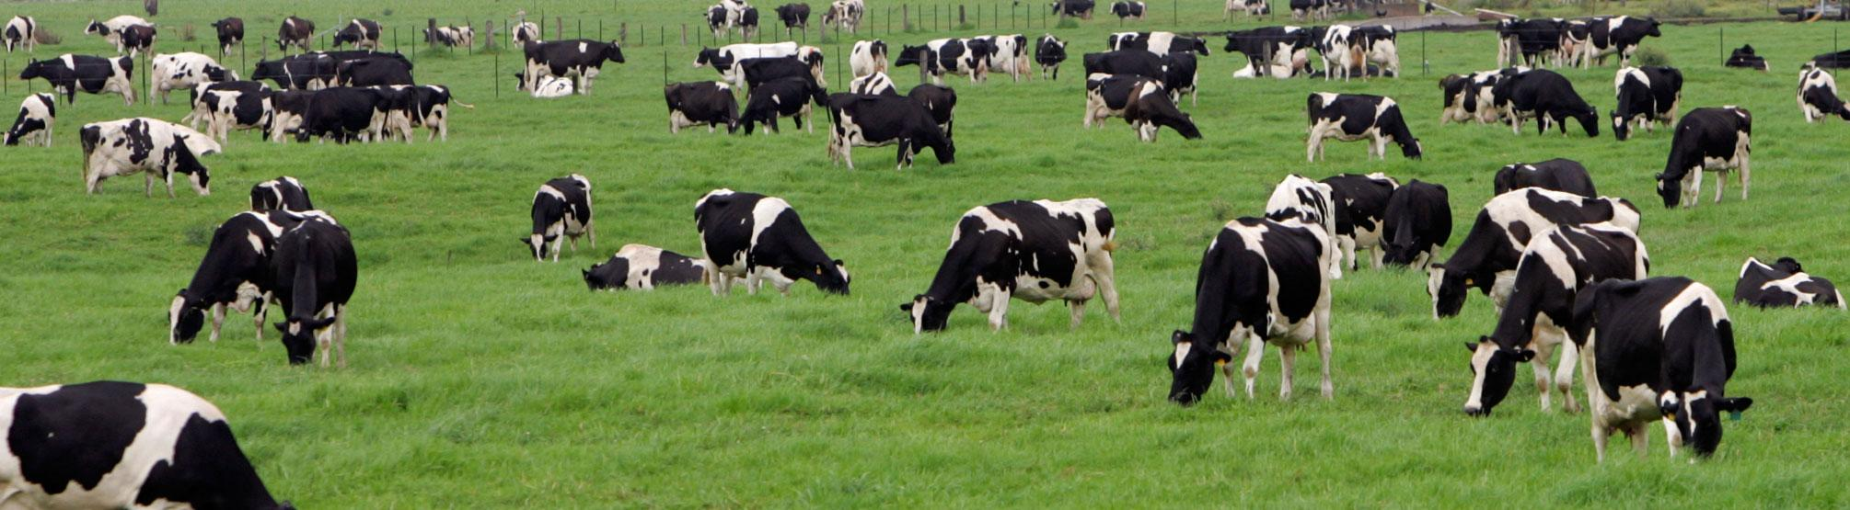
“Pets vs Cattle”
entire infra in code;
deployments via API
rack n’ stack,
cloud GUI

Slide 6
Why?
Higher confidence in changes
  since we’re switching to new infrastructure for each change, it’s very simple to rollback
  great for security patches!
Documentation without knowing we’re documenting!
  infrastructure as code, instead of infrastructure as procedures
  and tribal knowledge

Slide 7
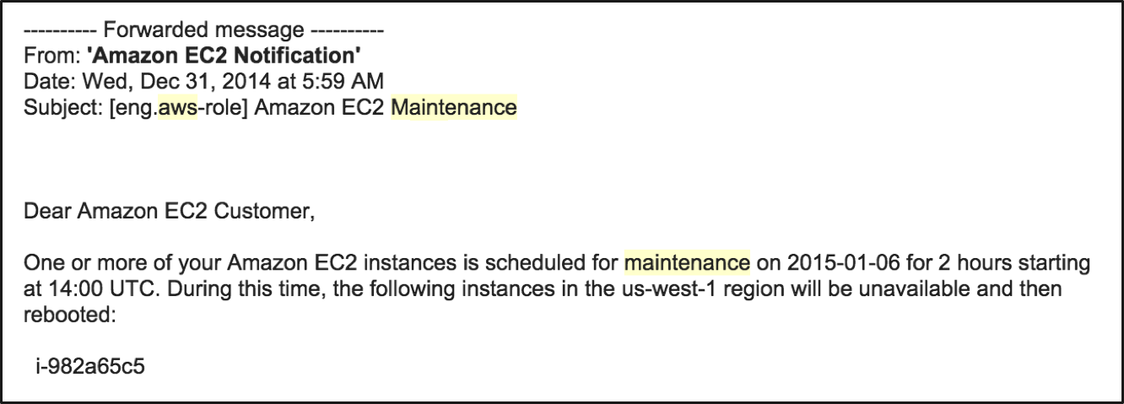
This shouldn’t scare you!

Slide 8



Deployment Workflow: Pre-Cloud
Remote KVM
$ uptime 12:40 up 4 years 22 days

Slide 9

Configuration Management

Slide 10
Deployment Workflow: Pre-Cloud
Remote KVM
$ uptime 12:40 up 4 years 22 days

Slide 11


Slide 12
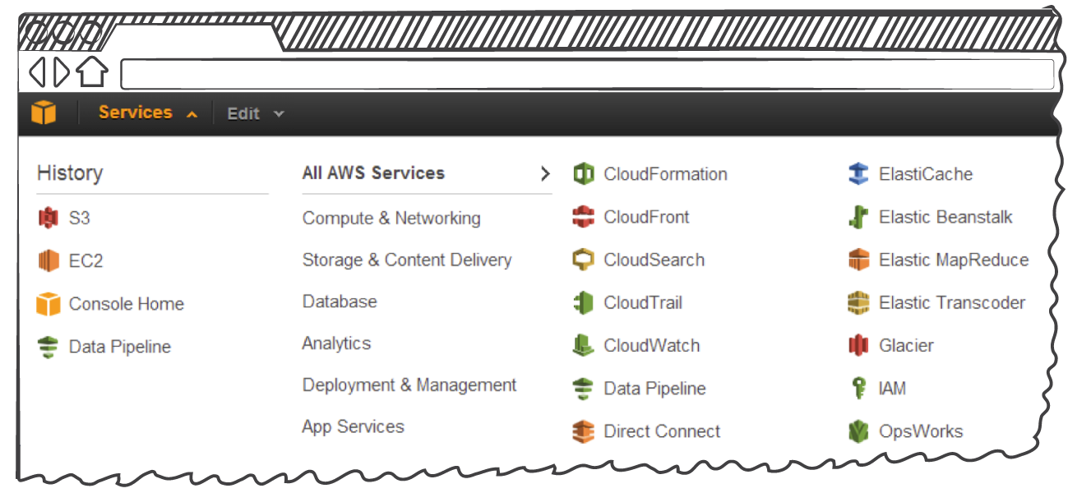
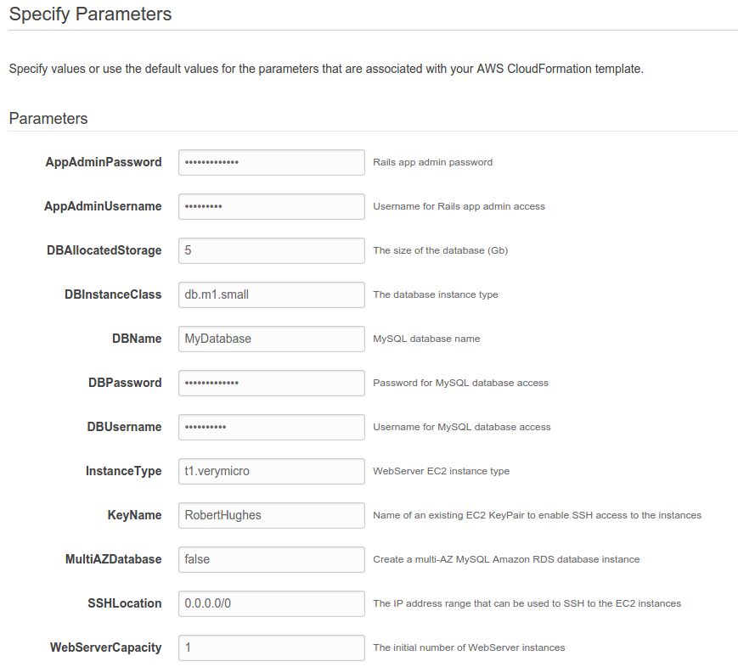
Deployment Workflow: Post-Cloud
$ uptime 12:40 up 4 years 22 days

Slide 13
Deployment Workflow: Post-Cloud
$ uptime 12:40 up 4 years 22 days

Slide 14


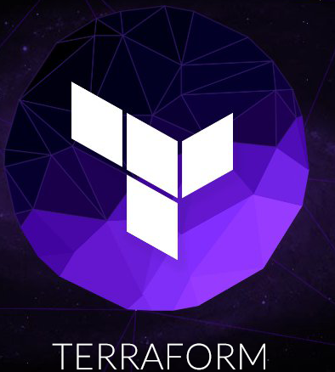

Deployment Workflow: Today’s Exercise
Base OS
Your App Config

Slide 15
Deployment Workflow: Today’s Exercise
Base OS
Custom Image
Infra as Code
Your App Config

Slide 16

Deployment Workflow: Today’s Exercise
Base OS
Custom Image
Infra as Code
Your App Config

Slide 17
What we’re building today
HTTP/80

Slide 18
Section 3
(app-1 out of rotation)
HTTP/80

Slide 19
Section 3
(app-1 in rotation)
HTTP/80

Slide 20
Section 4
(app-1 in rotation)
HTTP/80

Slide 21
Section 4
(both versions of the app in rotation)
HTTP/80

Slide 22
Section 4
(app-2 in rotation instead of app-1)
HTTP/80

Slide 23
Where do I go from here
Experiment with it!
  Try adding a fake SSH key to the AWS EC2 instance during build to force yourself not to login
Dev / Prod parity
  Re-using Terraform configuration across both
    1. “terraform apply” in dev
    2. switch AWS keys to point to prod
    3. “terraform apply” in prod

Slide 24
Thank you!
Feedback, or just to update on applying these techniques back @ work:
chris[at]chrisdorros[dot]com

